Slide 1
Object Oriented Programming in JAVA

Slide 2
Introduction
Welcome to the course Advance Object Oriented Programming in JAVA. This course will cover a core set of computer science concepts needed to create a modern software application using Java.

Slide 3
Course Objectives
On completion of this course we will be able to:
Identify the importance of Java .
Identify the additional features of Java compared to C++ .
Identify the difference between Compiler and Interpreter .
Identify the difference between applet and application .
Apply Advance Object Oriented Principles of Encapsulations, Data abstraction, Inheritance, Polymorphism.
Program using java API (Application Programming Interface).
Program using Exception Handling, Files and Threads .
Program Using applets and swings .

Slide 4
JAVA Basics

Slide 5
Why Java is Important
Two reasons :
Trouble with C/C++ language is that they are not portable and are not platform independent languages.
Emergence of World Wide Web, which demanded portable programs
Portability and security necessitated the invention of Java

Slide 6
History
James Gosling - Sun Microsystems
Co founder – Vinod Khosla
Oak - Java, May 20, 1995, Sun World
JDK Evolutions
JDK 1.0 (January 23, 1996)
JDK 1.1 (February 19, 1997)
J2SE 1.2 (December 8, 1998)
J2SE 1.3 (May 8, 2000)
J2SE 1.4 (February 6, 2002)
J2SE 5.0 (September 30, 2004)
Java SE 6 (December 11, 2006)
Java SE 7 (July 28, 2011)
Notes:
Java was conceived by james gosling,patrick naughton….
Java was initially called as Oak..
But renamed as java in 1995
Standard edition, management edition, enterprise edition (used for adv.. Java concepts)
You can write the java program in any editors, notepads. But it will be easy if you use editplus

Slide 7
Cont..
Java Editions.
J2SE(Java 2 Standard Edition) - to develop client-side standalone applications or applets.
J2ME(Java 2 Micro Edition ) - to develop applications for mobile devices such as cell phones.
J2EE(Java 2 Enterprise Edition ) - to develop server-side applications such as Java servlets and Java ServerPages.

Slide 8
What is java?
A general-purpose object-oriented language.
Write Once Run Anywhere (WORA).
Designed for easy Web/Internet applications.
Notes:
Due to the simillarities of java with C++ it si called “Internet version of C++”
Based on C/C++

Slide 9
How is Java different from C…
C Language:
Major difference is that C is a structure oriented language and Java is an object oriented language and has mechanism to define classes and objects.
Java does not support pointer type
Java does not have preprocessor, so we cant use #define, #include and #ifdef statements.
Java does not include structures, unions and enum data types.
Java does not include keywords like goto, sizeof and typedef.
Java adds labeled break and continue statements.
Java adds many features required for object oriented programming.

Slide 10
How is Java different from C++…
C++ language
Features removed in java:
Java doesn’t support pointers to avoid unauthorized access of memory locations.
Java does not include structures, unions and enum data types.
Java does not support operator over loading.
Preprocessor plays less important role in C++ and so eliminated entirely in java.
Java does not perform automatic type conversions that result in loss of precision.

Slide 11
Cont…
Java does not support global variables. Every method and variable is declared within a class and forms part of that class.
Java does not support inheritance of multiple super classes by a sub class (i.e., multiple inheritance). This is accomplished by using ‘interface’ concept.
It is not possible to declare unsigned integers(Unsigned can hold a larger positive value, and no negative value.
In java objects are passed by reference only. In C++ objects may be passed by value or reference.

Slide 12
Cont …
New features added in Java:
Multithreading, that allows two or more pieces of the same program to execute concurrently.
C++ has a set of library functions that use a common header file. But java replaces it with its own set of API(Application Programming Interface) classes.
It adds packages and interfaces.
Java supports automatic garbage collection.
break and continue statements have been enhanced in java to accept labels as targets.

Slide 13
Cont …
Features that differ:
Though C++ and java supports Boolean data type, C++ takes any nonzero value as true and zero as false. True and false in java are predefined literals that are values for a boolean expression.
Java has replaced the destructor function with a finalize() function.
C++ supports exception handling that is similar to java's. However, in C++ there is no requirement that a thrown exception be caught.

Slide 14
Characteristics of Java
Java is simple
Java is object-oriented
Java is distributed
Java is interpreted
Java is robust
Java is architecture-neutral
Java is portable
Java’s performance
Java is multithreaded
Java is dynamic
Java is secure

Slide 15
Simple
According to Sun, Java language is simple because syntax is based on C++ (so easier for programmers to learn it after C++). It removed many confusing and/or rarely-used features e.g., explicit pointers, operator overloading etc. No need to remove unreferenced objects because there is Automatic Garbage Collection in java.
Object-oriented
Object-oriented means we organize our software as a combination of different types of objects that incorporates both data and behavior. Object-oriented programming(OOPs) is a methodology that simplify software development and maintenance by providing some rules.
Platform Independent
A platform is the hardware or software environment in which a program runs.
There are two types of platforms software-based and hardware-based. Java provides software-based platform.
The Java platform differs from most other platforms in the sense that it is a software-based platform that runs on the top of other hardware-based platforms.

Slide 16
Secured
Java is secured because:
No explicit pointer
Java Programs run inside virtual machine sandbox
Robust
Robust simply means strong. Java uses strong memory management. There are lack of pointers that avoids security problem. There is automatic garbage collection in java. There is exception handling and type checking mechanism in java. All these points makes java robust.

Slide 17
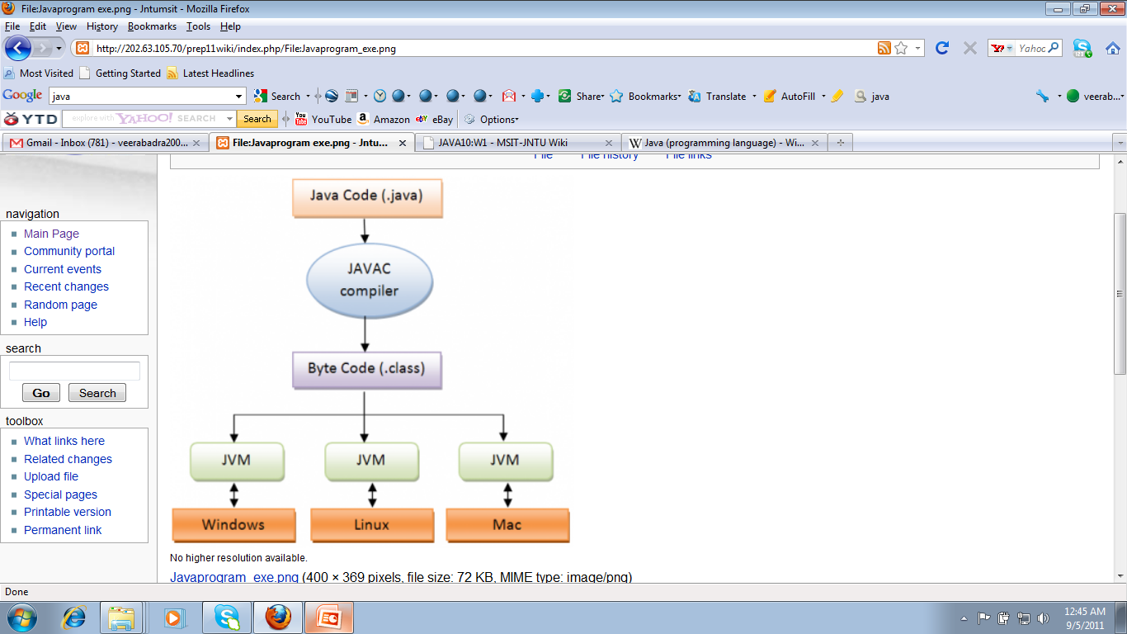
Architecture-neutral
There is no implementation dependent features e.g. size of primitive types is fixed.
In C programming, in data type occupies 2 bytes of memory for 32-bit architecture and 4 bytes of memory for 64-bit architecture. But in java, it occupies 4 bytes of memory for both 32 and 64 bit architectures.

Slide 18
Portable
We may carry the java bytecode to any platform.
High-performance
Java is faster than traditional interpretation since byte code is "close" to native code still somewhat slower than a compiled language (e.g., C++)
Distributed
We can create distributed applications in java. RMI and EJB are used for creating distributed applications. We may access files by calling the methods from any machine on the internet.
The RMI (Remote Method Invocation) is an API that provides a mechanism to create distributed application in java. The RMI allows an object to invoke methods on an object running in another JVM.
EJB is an acronym for enterprise java bean. It is a specification provided by Sun Microsystems to develop secured, robust and scalable distributed applications
Interpreted
The compiler takes your .java file and compiles it into a .class file (the .class file contains Java byte code).
The interpreter comes in when your program is run. The JVM (or interpreter) takes your .class file and interprets it.
Multi-threaded
A thread is like a separate program, executing concurrently. We can write Java programs that deal with many tasks at once by defining multiple threads. The main advantage of multi-threading is that it doesn't occupy memory for each thread. It shares a common memory area. Threads are important for multi-media, Web applications etc.

Slide 19
Java Environment
Java includes many development tools, classes and methods
Development tools are part of Java Development Kit (JDK) and
The classes and methods are part of Java Standard Library (JSL), also known as Application Programming Interface (API).
JDK constitutes of tools like java compiler, java interpreter and many.
API includes hundreds of classes and methods grouped into several packages according to their functionality.

Slide 20
Example
File: HelloWorldApp.java
public class HelloWorldApp{
public static void main(String[] args) {
System.out.println("Hello world");
}
}
Notes:
Tell about
Public static void main()

Slide 21
Things to remember
Name of file must match name of class
It is case sensitive
Processing starts in main
public static void main(String[] args)
Printing is done with System.out
System.out.println, System.out.print

Slide 22
An idiom explained
You will see the following line of code often:
public static void main(String args[]) { …}
About main()
“main” is the function from which your program starts
Why public?
So that run time can call it from outside
Why static ?
it is made static so that we can call it without creating an object
What is String args[] ?
Way of specifying input at startup of application

Slide 23
Things to Remember
“+” operator when used with Strings concatenates them
System.out.pritln(“Hello” + “World”) will produce Hello World on console
String concatenated with any other data type such as int will also convert that datatype to String and the result will be a concatenated String displayed on console
For Example
int i = 4
int j = 5 ;
System .out.println (“Hello” + i) // will print Hello 4 on screen
However
System,.out..println( i+j) ; // will print 9 on the console
For comparing Strings never use == operator, use equals methos.
== compares addresses (shallow comparison) while equals compares values (deep comparison)
E.g string1.equals(string2)

Slide 24
String Concatenation
public class StringTest {
public static void main(String[] args) {
int i = 4;
int j = 5;
System.out.println("Hello" + i);
System.out.println(i + j);
String s1 = new String (“pakistan”);
String s2 = “pakistan”;
if (s1 == s2) {
System.out.println(“comparing string using == operator”);
}
if (s1.equals( s2) ) {
System.out.println(“comparing string using equal method”);
}
}
}

Slide 25
Primitives Vs. Objects

Slide 26
Primitives Vs. Objects
Everything in Java is an “Object”, as every class by default inherits from class “Object” , except a few primitive data types, which are there for efficiency reasons.
Primitive Data Types
8 Primitive Data types of java
boolean, byte → 1 byte
char, short → 2 bytes
int, float → 4 bytes
long, double → 8 bytes
Primitive data types are generally used for local variables, parameters and instance variables (properties of an object)
Primitive datatypes are located on the stack and we can only access their value, while objects are located on heap and we have a reference to these objects
Also primitive data types are always passed by value while objects are always passed by reference in java. There is no C++ like methods
void someMethod(int &a, int & b ) // not available in java

Slide 27
Primitives (cont)
For all built-in primitive data types java uses lowercase. E.g int , float etc
Primitives can be stored in arrays
You cannot get a reference to a primitive

Slide 28
Input / Output

Slide 29
Java Inputting
There are various ways to read input from the keyboard, the java.util.Scanner class is one of them.
The Java Scanner class breaks the input into tokens using a delimiter that is whitespace by default. It provides many methods to read and parse various primitive values.
Java Scanner class is widely used to parse text for string and primitive types using regular expression.
Java Scanner class extends Object class and implements Iterator and Closeable interfaces.

Slide 30
Console based Output System.out
System class
Out represents the screen
System.out.println()
Prints the string followed by an end of line
System.out.print()
Does not print the end of line

Slide 31
Thank you

